Slide 1
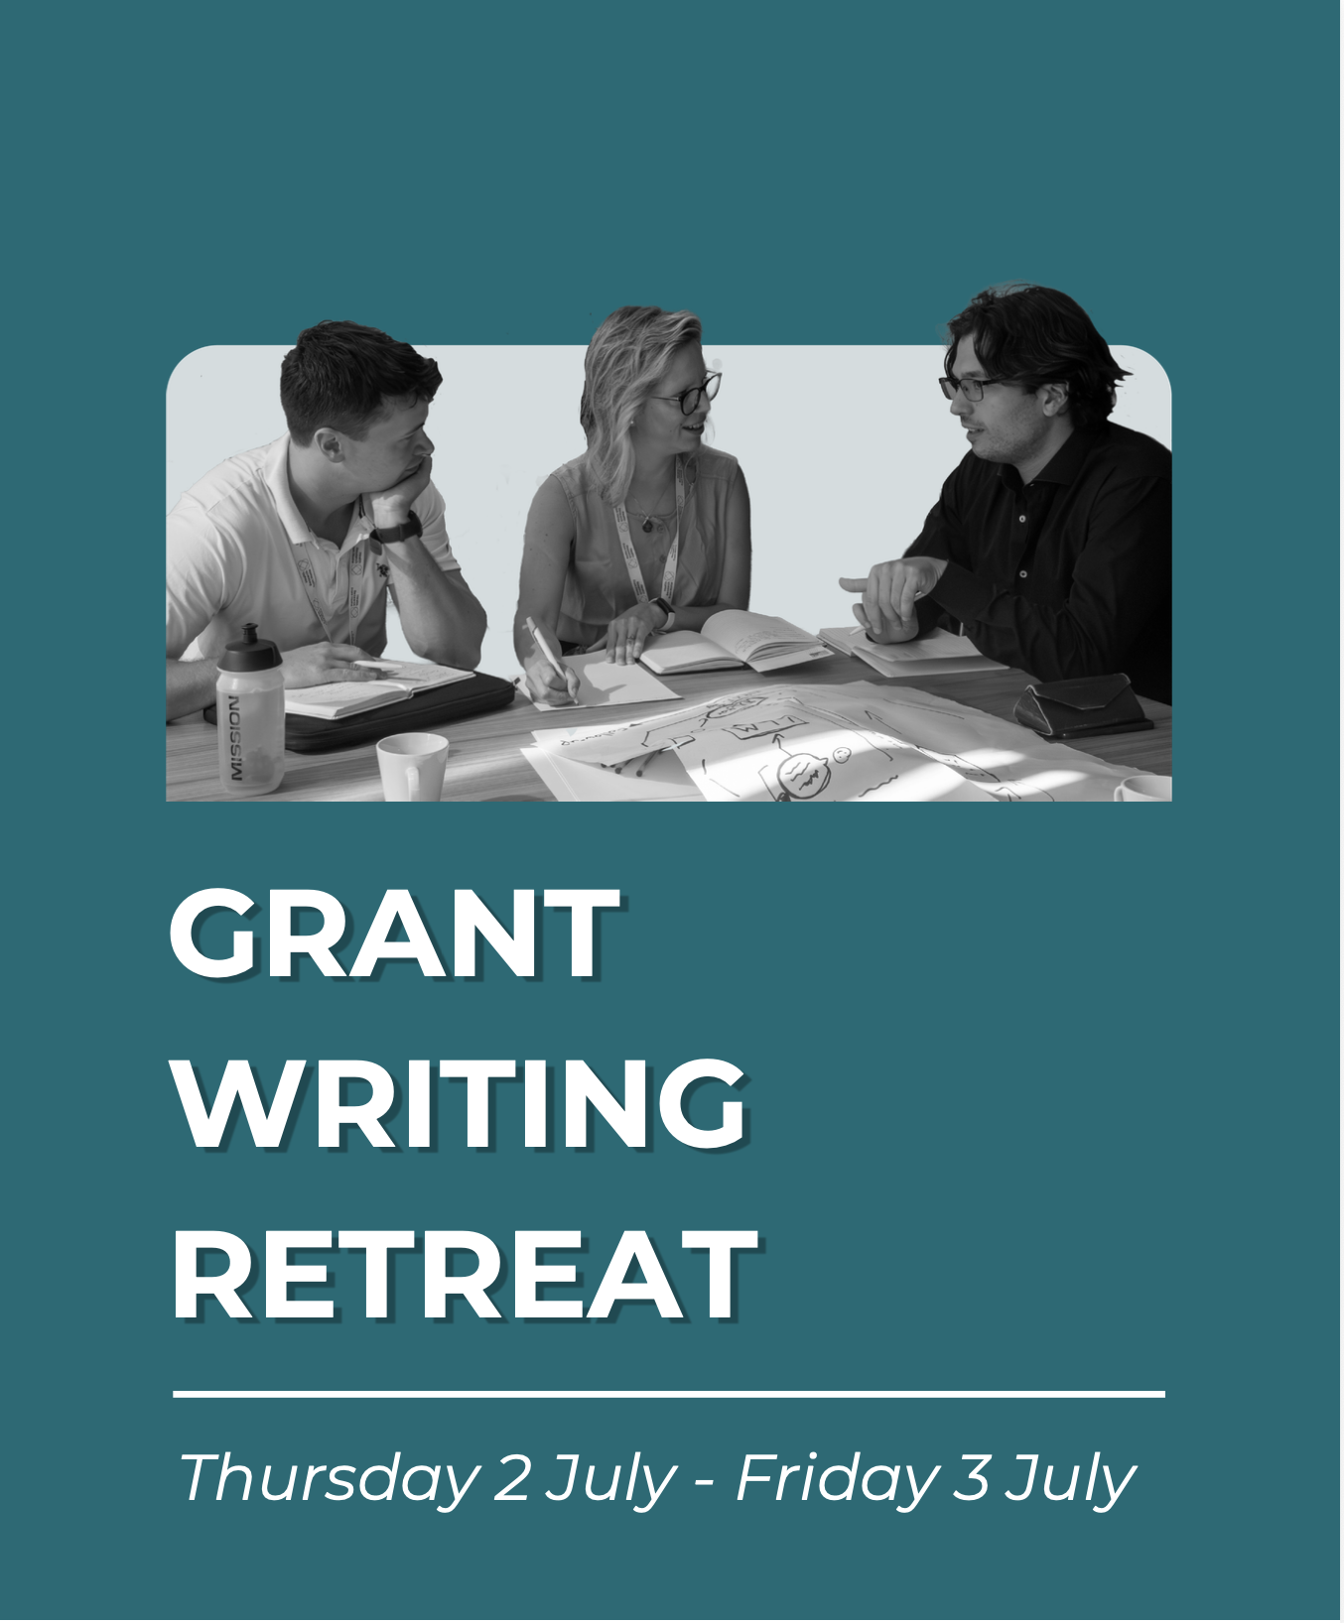

Slide 2

Opening session
Introduction to Health Research from Home
Purpose of the grant writing retreat
Agenda for the event
  And introduction to the faculty
Getting to know you

Slide 3
Opening session
Introduction to Health Research from Home
Purpose of the grant writing retreat
Agenda for the event
  And introduction to the faculty
Getting to know you

Slide 4
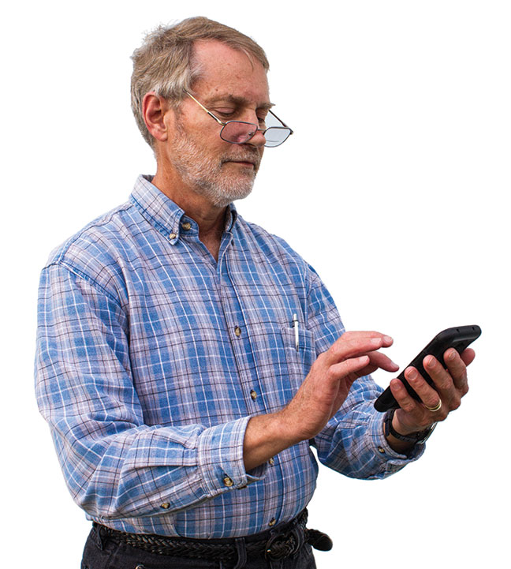
Clinical care
Population health
research
Self-management

Slide 5
The Opportunity
Smartphones and wearables provide global opportunity for the public to participate in relevant, meaningful health research
  Novel data collection (tracked symptoms, or measured activity or heart rate) integrated into people’s lives
  Time series data – day-to-day changes, measured between clinical visits
  Mass participation

Slide 6
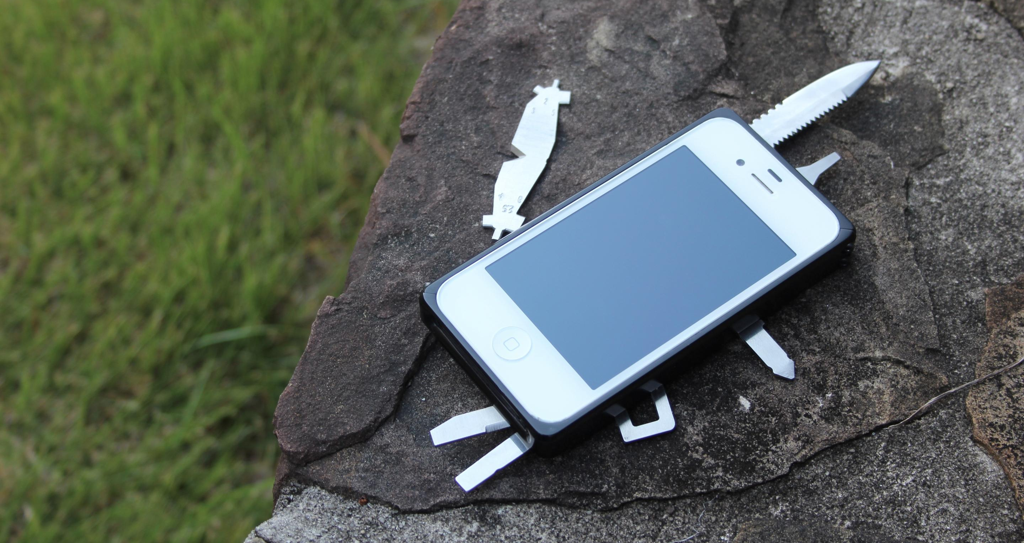
1. Novel data collection
Touch screen
  Questionnaires
  Smartphone interactions
Accelerometer + gyroscope
  Physical activity
Camera
  Heart rate, respiratory rate
  Video selfies
Microphone
  Voice commands
  Cough, snore, tremor
GPS
  Geolocation

Slide 7
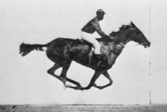
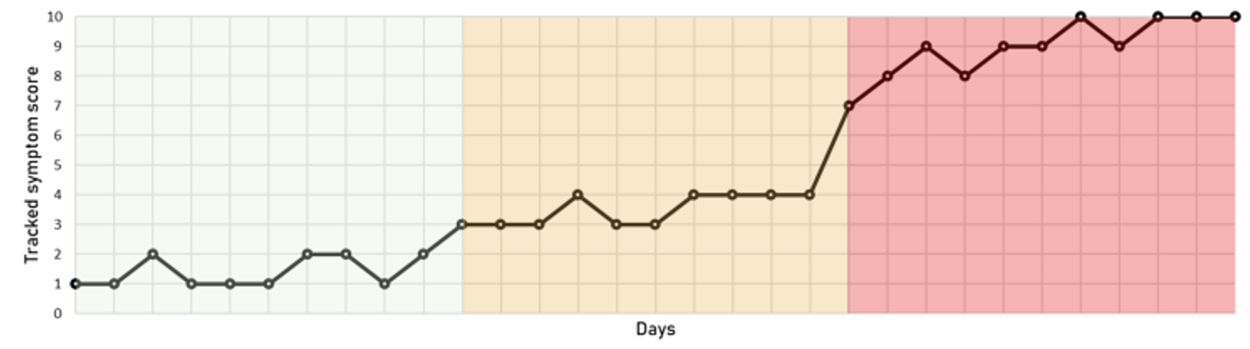
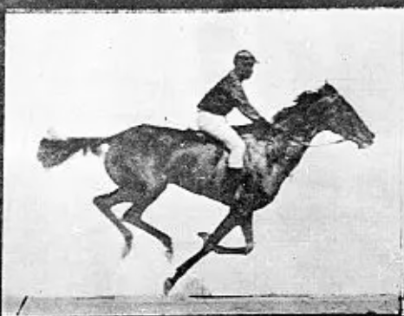
2. Tracking disease through time
?
Time

Slide 8
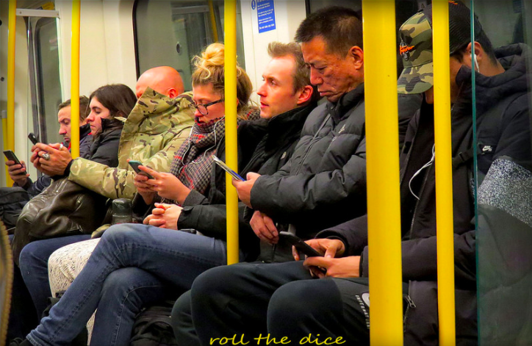
3. Widespread use
Image: Roll the Dice

Slide 9
The Opportunity
Smartphones and wearables provide global opportunity for the public to participate in relevant, meaningful health research*
  Novel data collection, integrated into people’s lives
    Active e.g. tracked symptoms
    Passive e.g. physical activity or heart rate
  Time series data: day-to-day changes, measured between clinical visits
  Mass participation
  * e.g. James Lind Alliance Top 10, Inflammatory Bowel Disease
  “What role does diet have in the management of mildly active or inactive ulcerative colitis or Crohn’s Disease to achieve normal daily activities and symptom control”

Slide 10
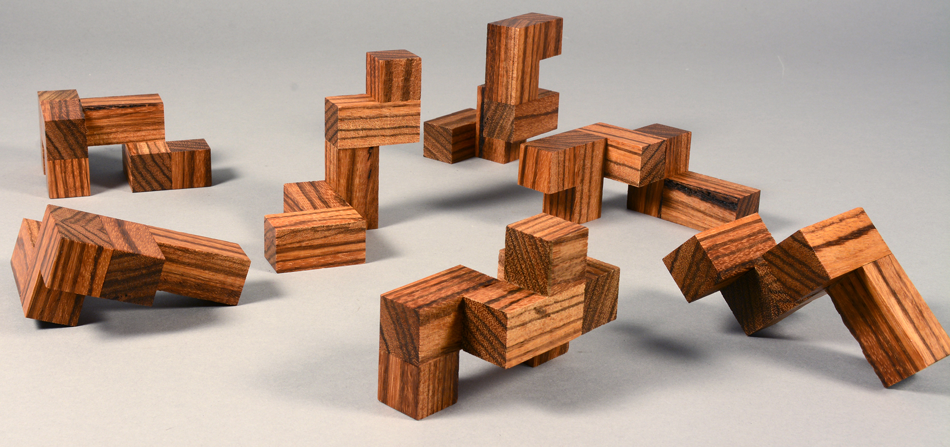
The Challenges
Despite case studies of good success, patient-generated health data (PGHD) research has not delivered at scale
“Lack of collective know-how”
Research
Question
Protocol/
Grant
Platform/
Data flow
Data
items
Recruitment/
Onboarding
Data Collection
Data Storage/
Linkage
Analysis, results & feedback
Onward
Sharing
>
>
>
>
>
>
>
>

Slide 11
Health Research
from Home

Slide 12


How bad is your
pain today?
0
10
Share best practice for using
smartphones and wearables
for population health research

Slide 13
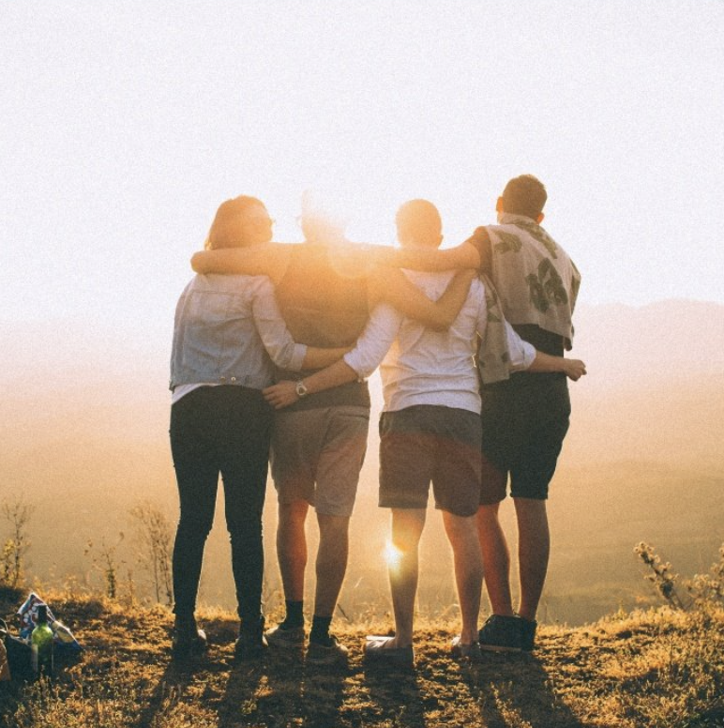

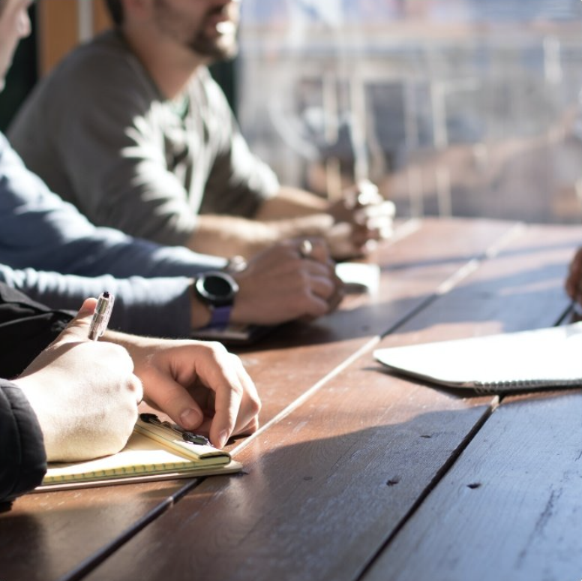
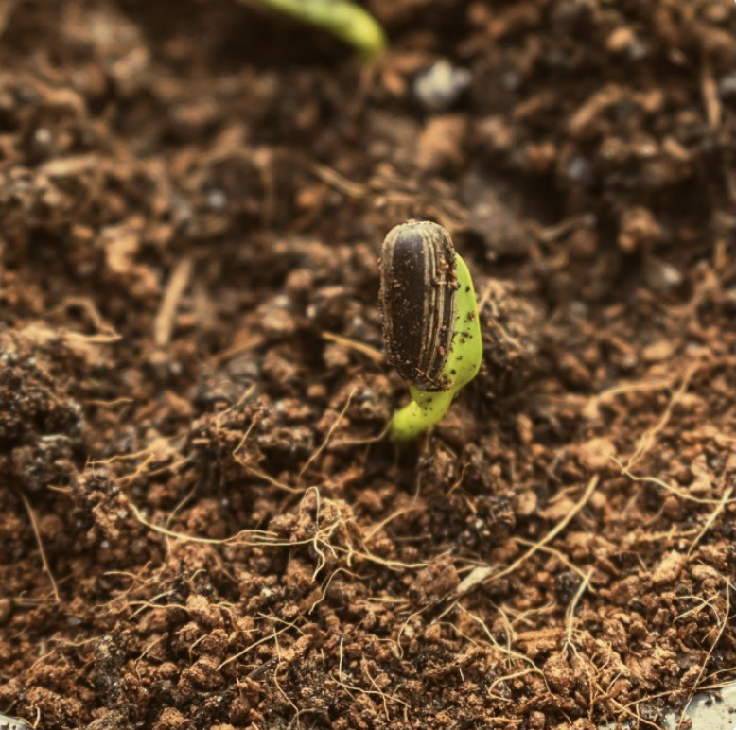
Purpose, vision, mission, values
Our purpose
To improve the lives of people living with long-term conditions
Our vision
To make the UK a world-leader in large-scale, high quality health research using smartphones and wearables, with linkage to national health data assets
Our mission
To build a collaborative community sharing know-how, skills and experience to catalyse and enable future ‘Health Research from Home’
Our values
Creating a cross-sector environment and public partnership where excellent ideas will thrive, inclusive of all perspectives and disciplines

Slide 14
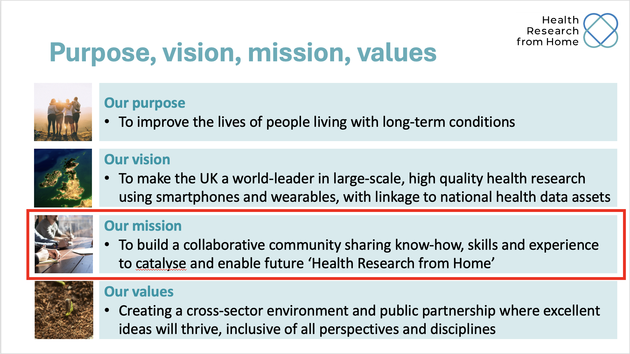
Opening session
Introduction to Health Research from Home
Purpose of the grant writing retreat
Agenda for the event
  And introduction to the faculty
Getting to know you

Slide 15
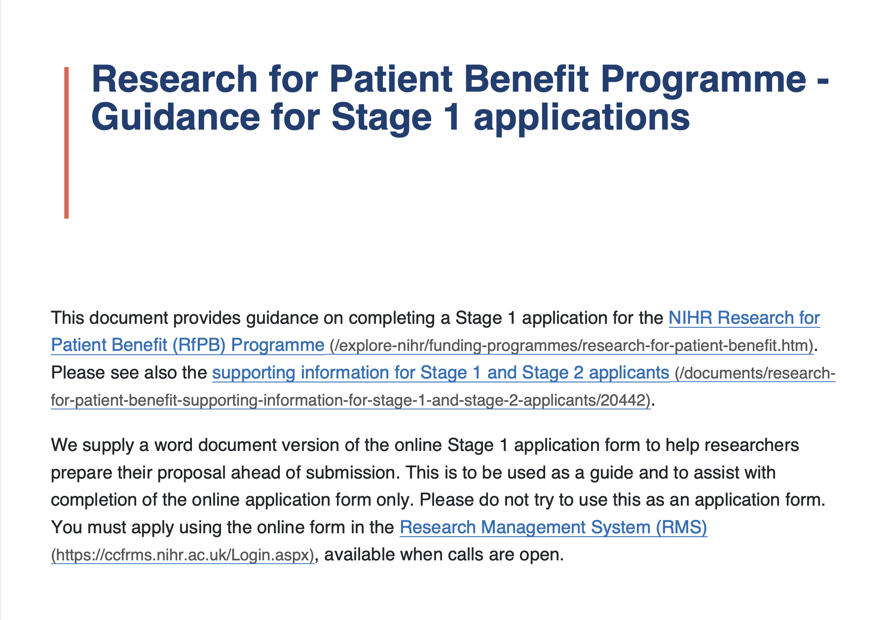
Purpose of the grant writing retreat
To help you present a better (and successful) grant application, with particular focus on grants specific to smartphones and wearables
  Background
  Aims and objectives
  Methods
  PPIE

Slide 16
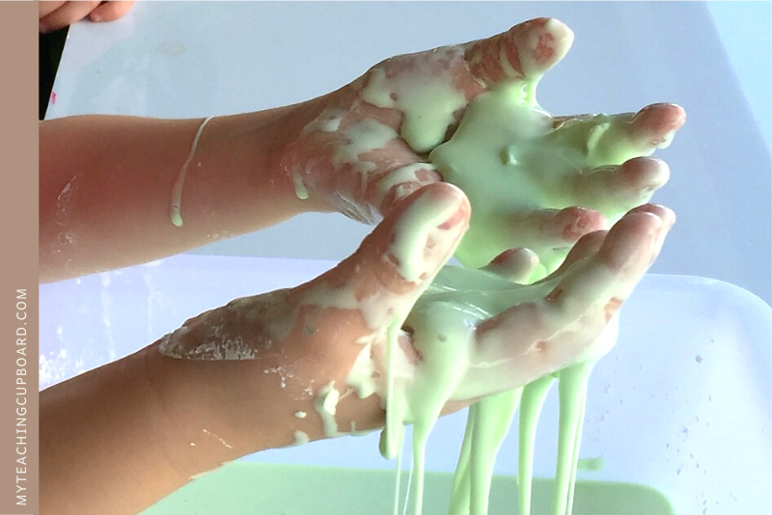
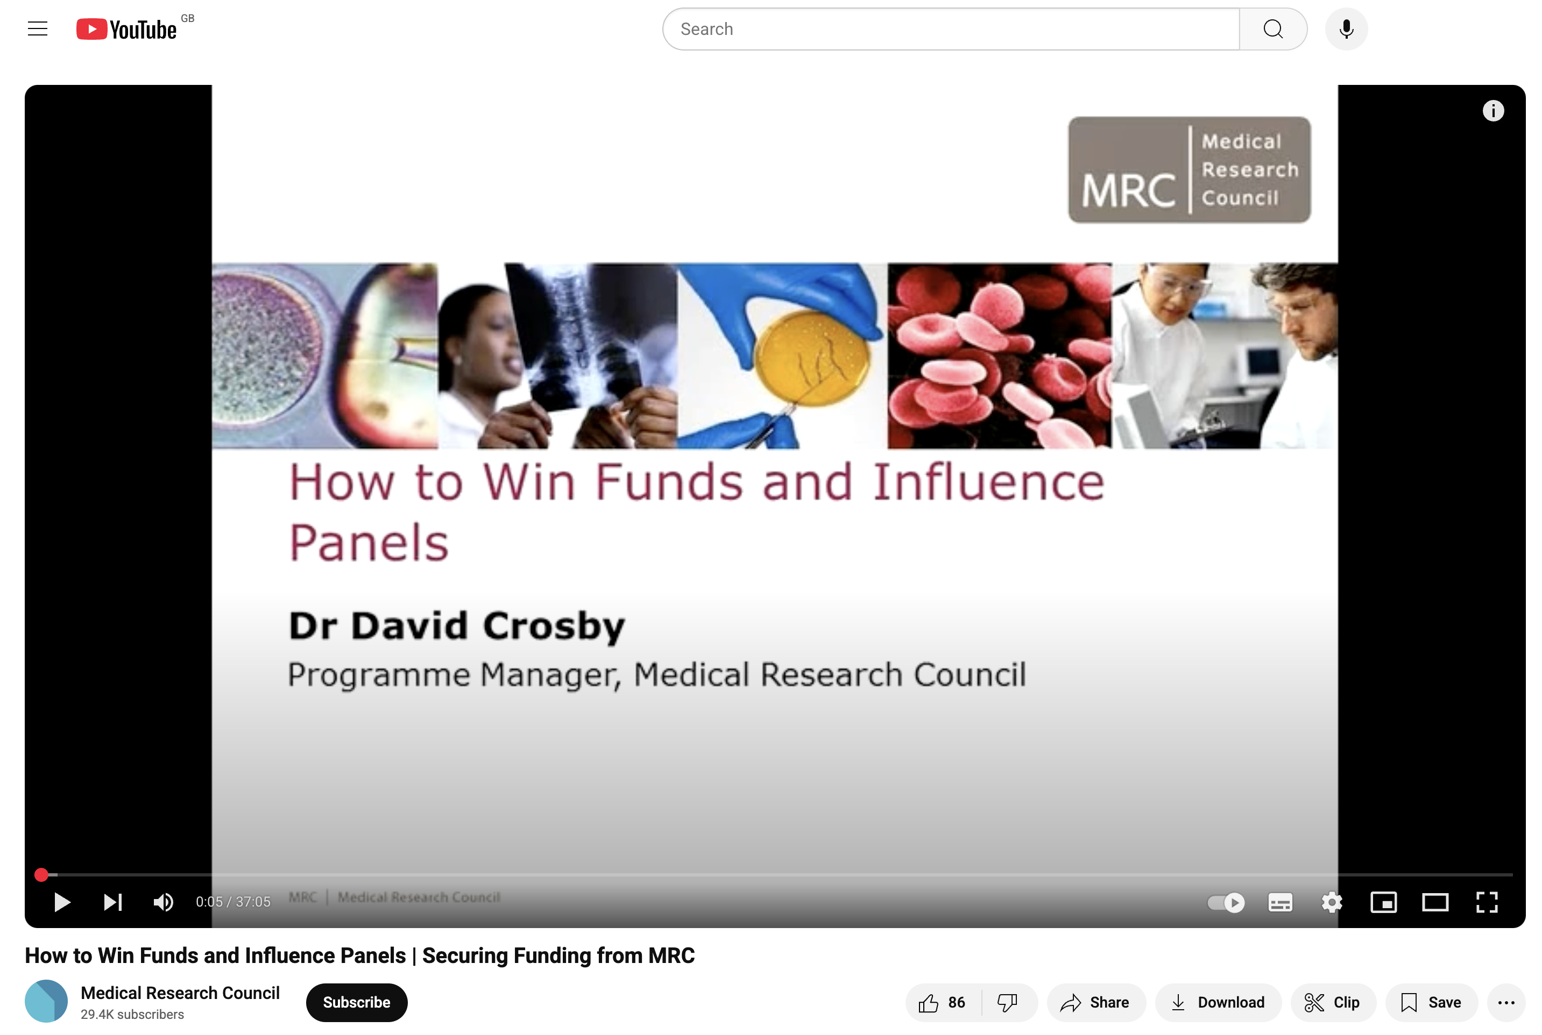

Slide 17
Opening session
Introduction to Health Research from Home
Purpose of the grant writing retreat
Agenda for the event
  And introduction to the faculty
Getting to know you

Slide 18
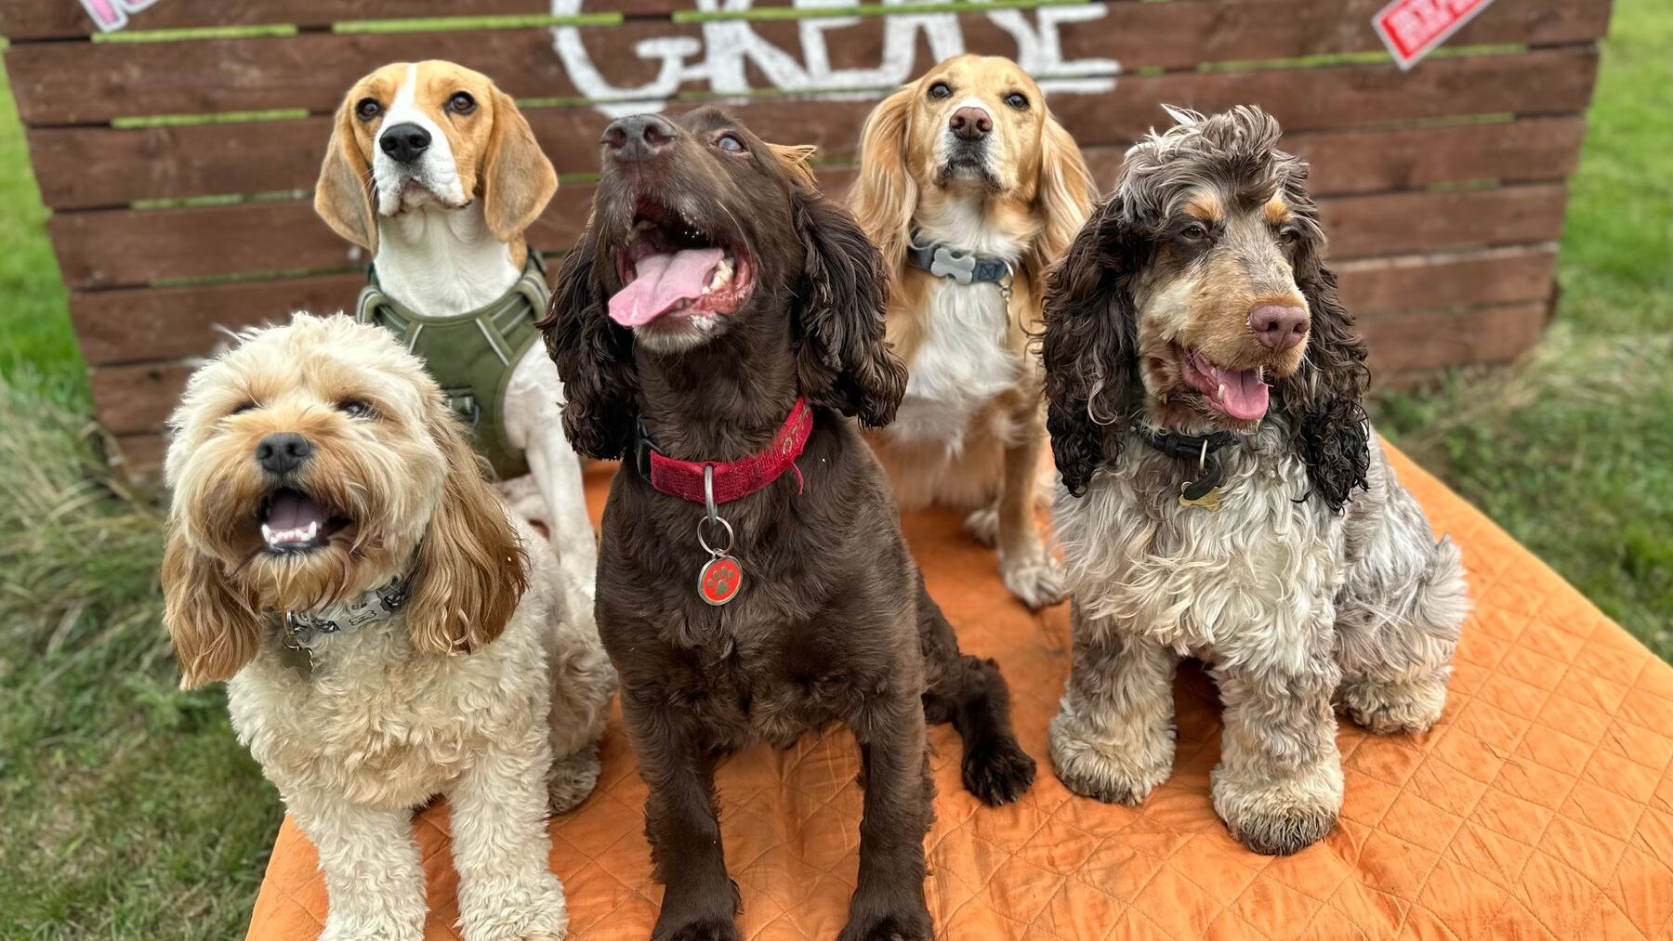
Introduction to the faculty

Slide 19
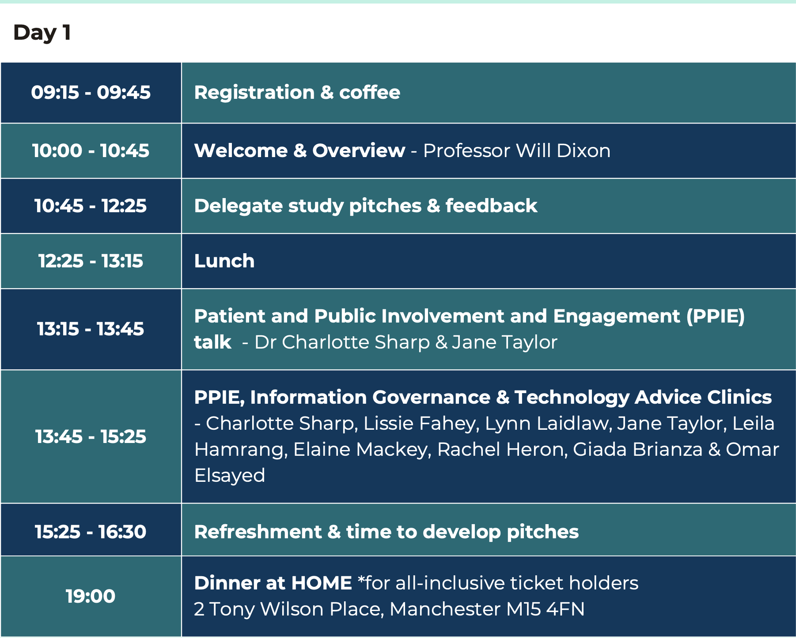

Slide 20
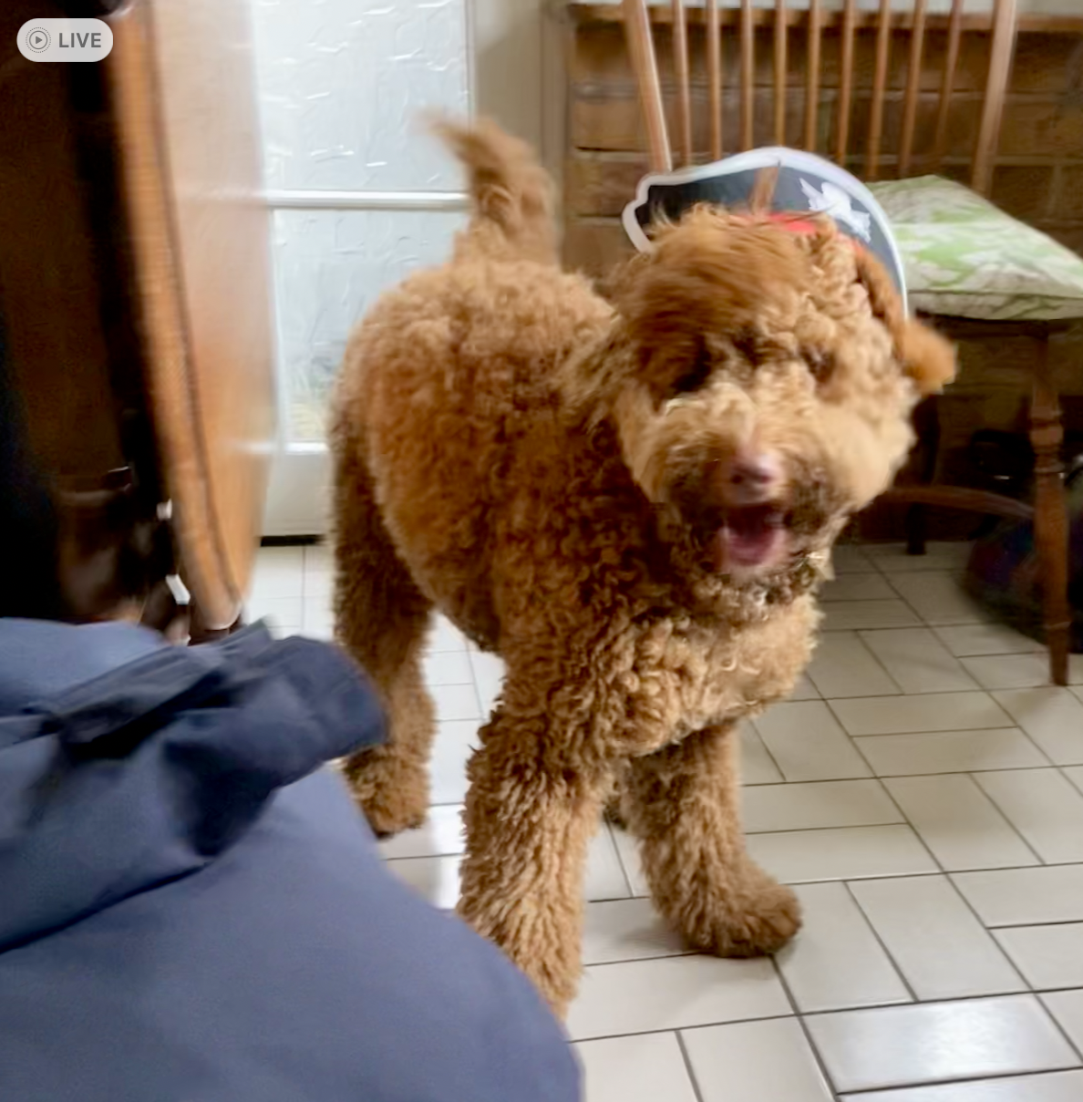
Will Dixon
Prof of Digital Epidemiology
Consultant Rheumatologist
Lead for Health Research from Home
Adjusting to life with a dog

Slide 22
Pitches v1
5min presentation of a study idea using smartphones +/or wearables
To include
  Background/ motivation
  Aims and objectives
  Methods e.g.
    Population, what data is collected and how, analysis plan
Each group of 5-6 to select a project to take forwards

Slide 23
Pitches v1
Two academics with public contributors
Divided into three groups
Group 1
  Will, Leila, Lissie, Giada
Group 2
  Charlotte, Jane, Omar
Group 3
  Sabine, Charlie, Lynn

Slide 24
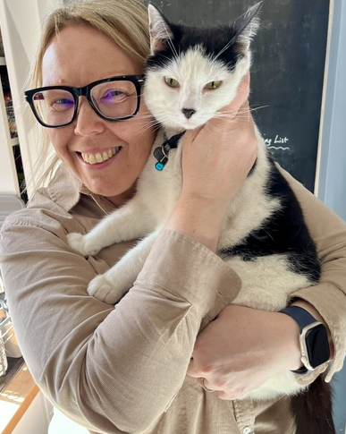
Charlie Stockton-Powdrell
Information Systems Programme Manager
Lead for Digital Health Software Team
Hugo Da Boss rules the roost & often demands belly rubs during my working day!

Slide 26
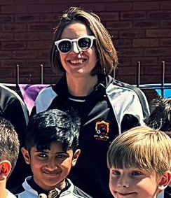
Charlotte Sharp
Honorary Senior Clinical Lecturer
Consultant Rheumatologist
Academic lead for patient and public involvement and engagement
My toughest role in life is coaching u9s football

Slide 27
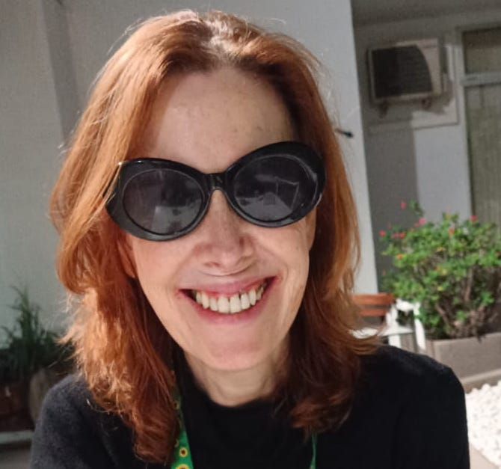
Jane Taylor
Public Contributor – co-produced research for over 20 years as both a patient and a carer.
Worked with a number of research organisations and funders, national and international, to encourage the involvement of patients/carers in all aspects of the research process.
She's also a carer and part time academic so any spare time is usually spent watching Netflix with a bottle of wine!

Slide 29
Advice clinics
PPIE
  Charlotte, Lissie, Lynn, Jane and Leila
Information Governance
  Elaine and Rachel
Technology
  Giada and Omar
Incorporate your learning into your Day 2 pitches

Slide 30
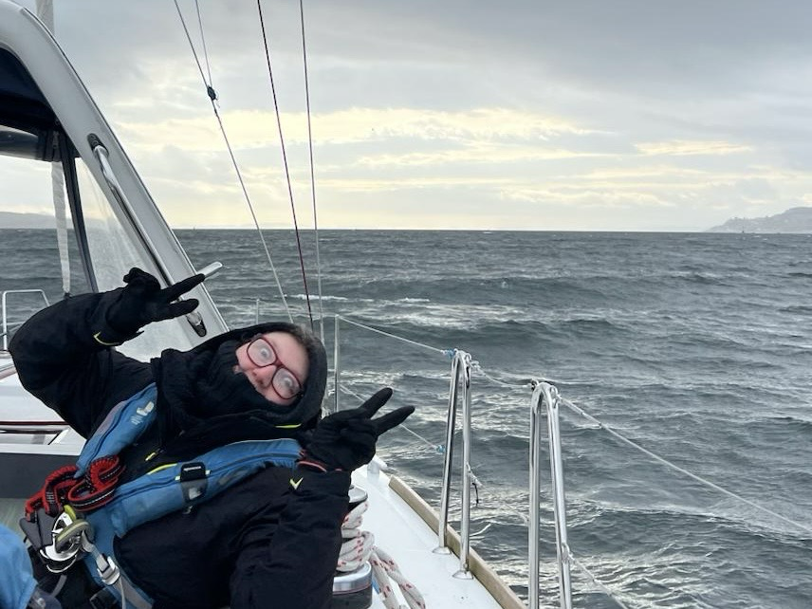
Leila Hamrang
Add picture outside of work
Public Contributor working with clinical researchers to improve public/patient engagement
Co-applicant
Enjoys playing wheelchair rugby and basketball, sailing and being creative!

Slide 31
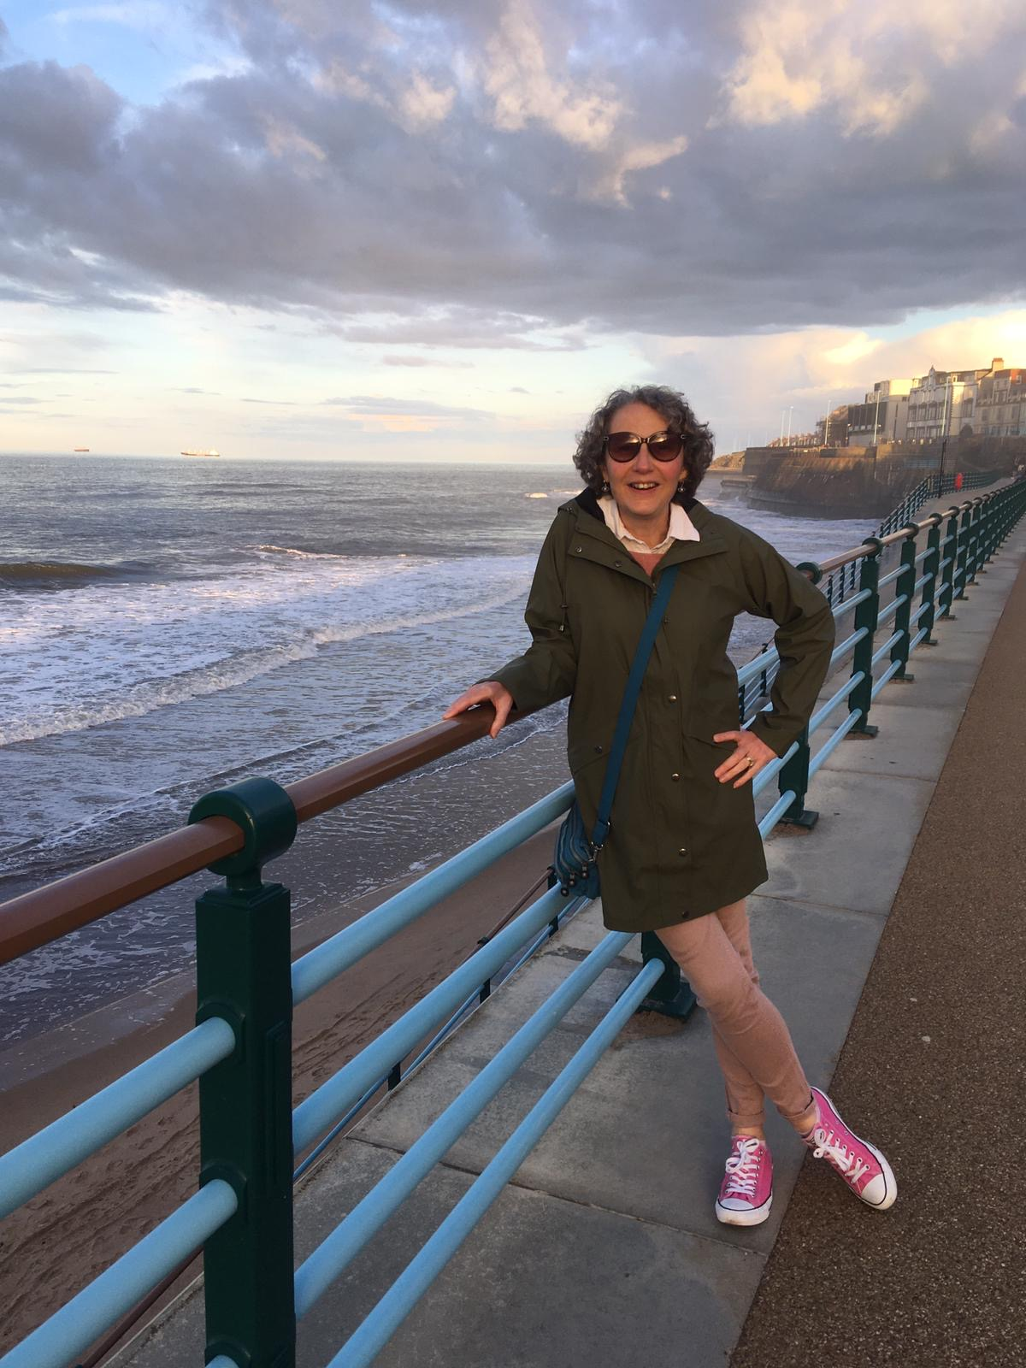
Lynn Laidlaw
Patient and public partner Co- Investigator for Health Research from Home
Enjoys living on the beautiful North East Coast
Loves a cocktail and eating out, especially seafood

Slide 32
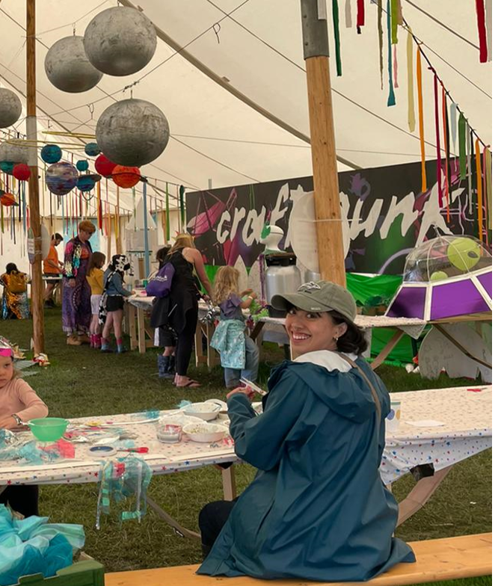
Lissie Fahey
Public and Patient Involvement and Engagement Project Manager
Facilitating the responsible use of safety scissors at blue dot festival. I enjoy crafting, camping and useful play!

Slide 33
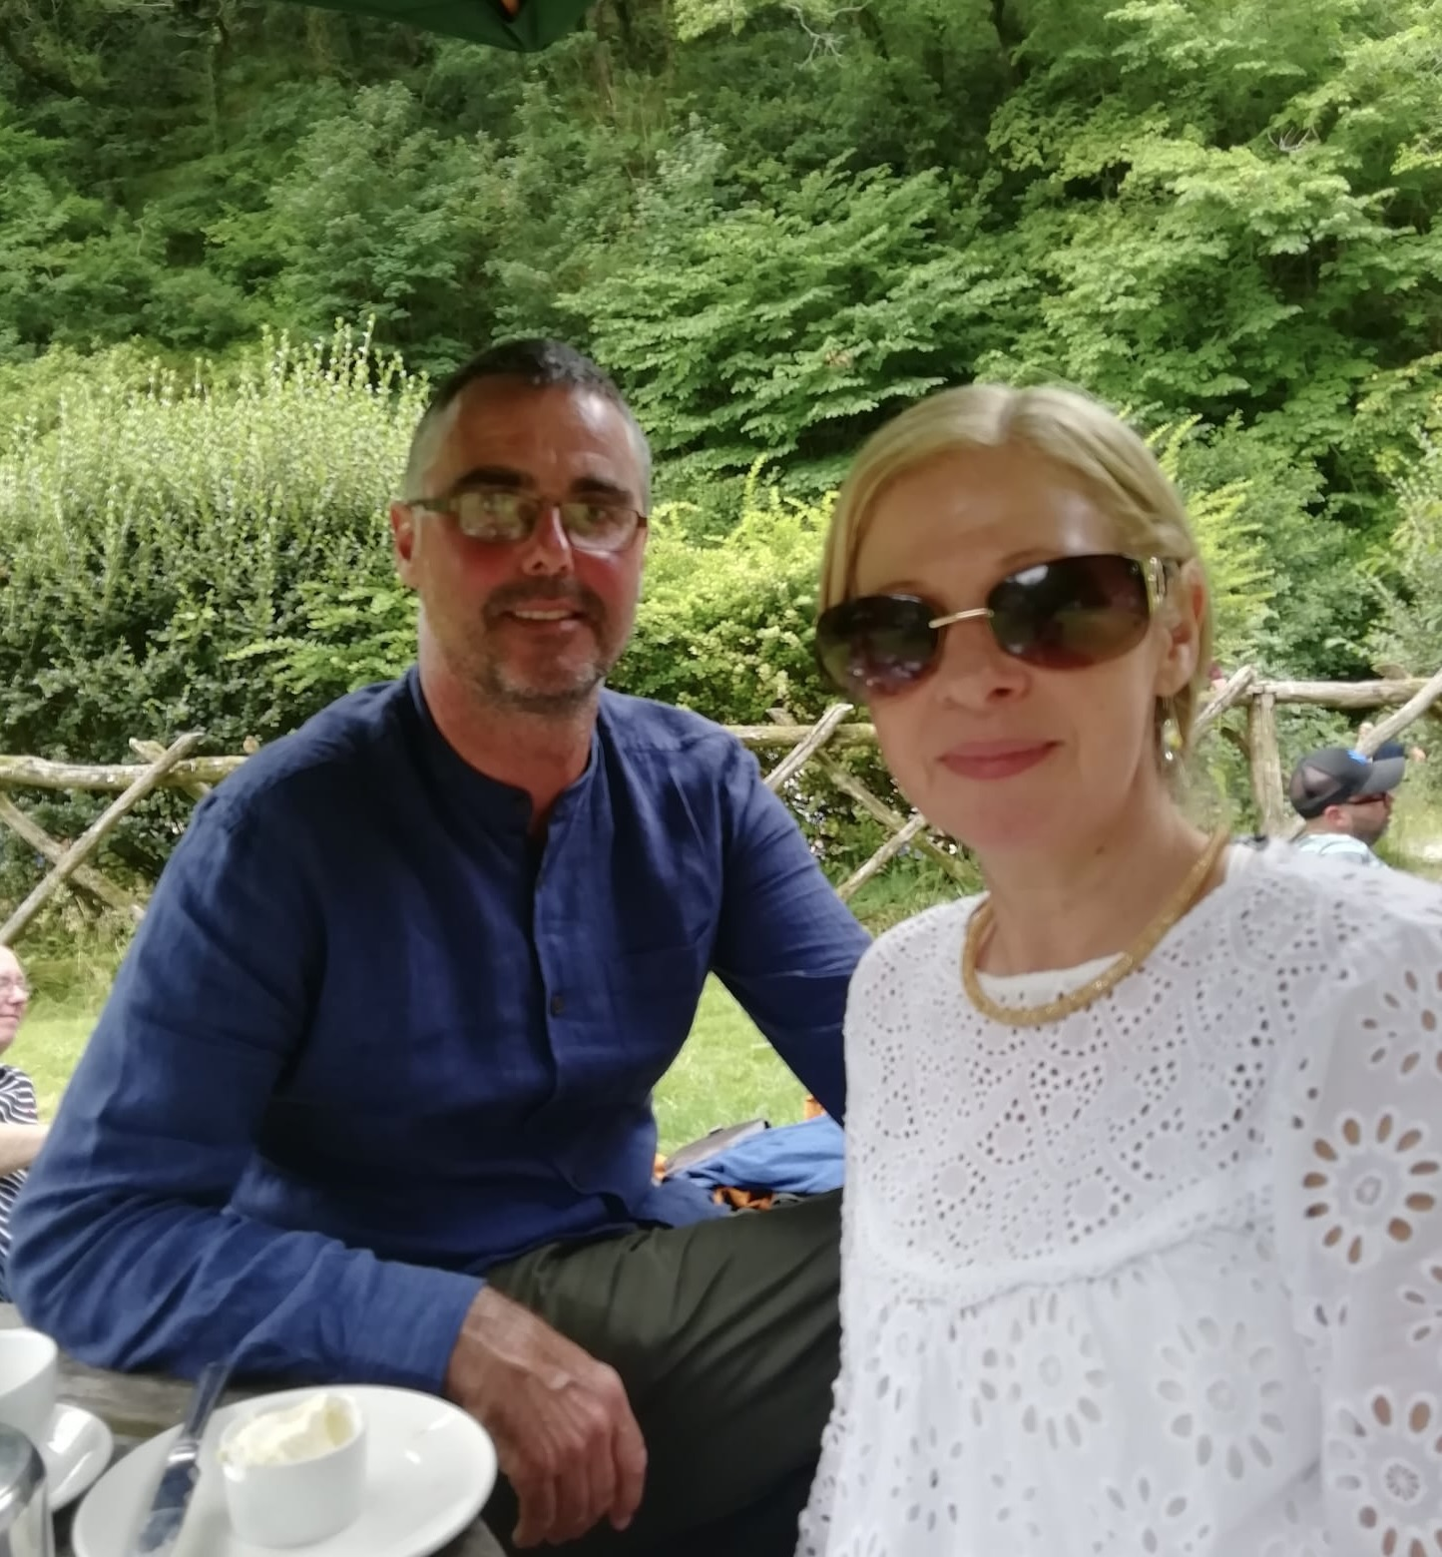
Elaine Mackey
Add picture outside of work
Research Information Governance Manager
Expertise in anonymization and data confidentiality
Enjoy walking, preferably when cake is involved

Slide 34
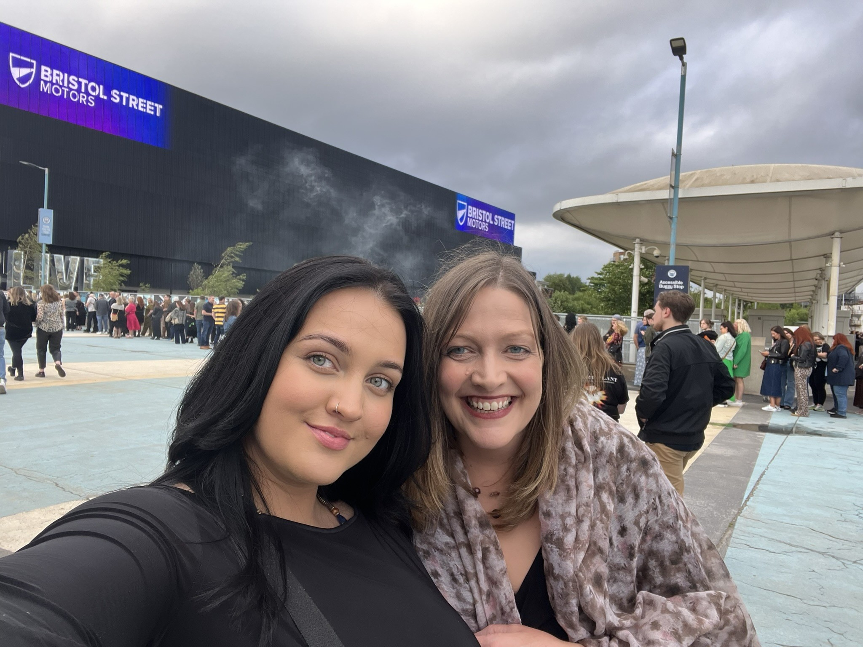
Rachel Heron
Research Ethics & Governance Manager at Manchester Metropolitan University
Expertise in research ethics and governance
Enjoy live music

Slide 35
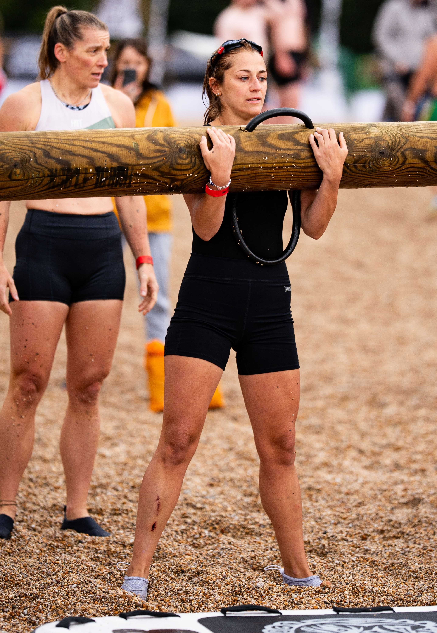
Giada Brianza
Never left academia since 2013 (my BSc);
Currently, Project Manager in mHealth and Wearable Technology;
PhD and Postdoc in HCI, specialised in smell training research with a focus on co-production and responsible innovation
I “suffer” from asparagus anosmia [if you didn’t know, it is the lack of detecting asparagus smell];
I am part of a dangerous cult called Crossfit;
Despite my Italian passport, I am not a fan of pizza and don’t eat pasta.

Slide 36
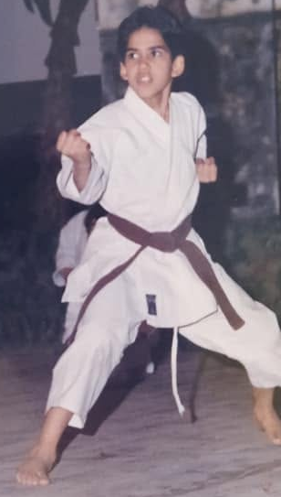
Omar Khaled
Senior Product Manager
of Digital Health &
EdTech Entrepreneur
by day
Karate Kid
by night

Slide 38
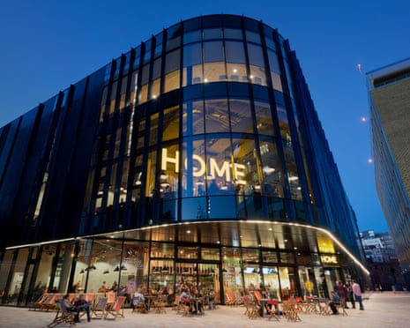

Slide 39
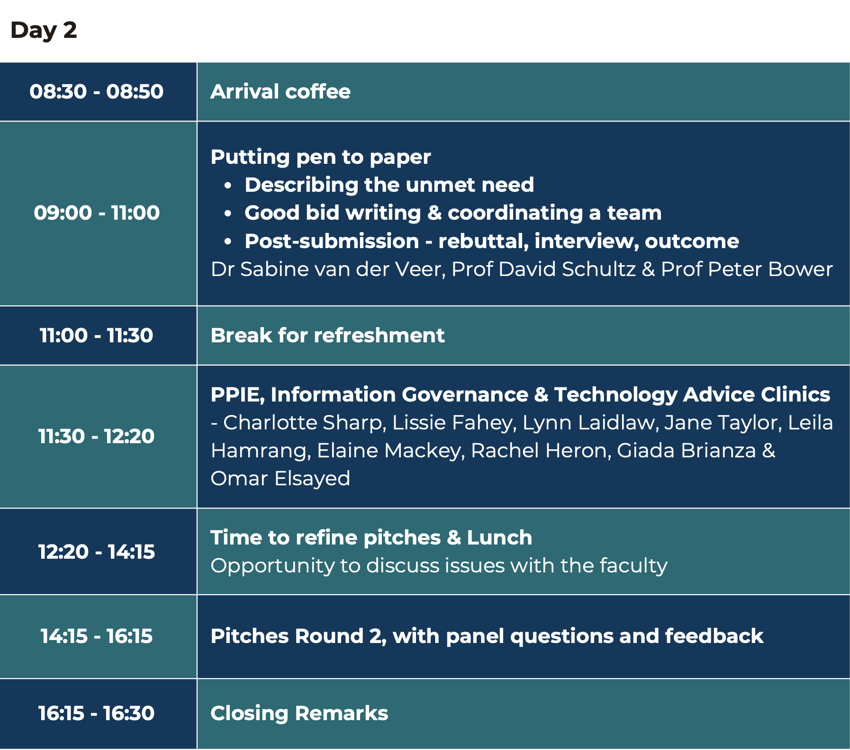

Slide 40
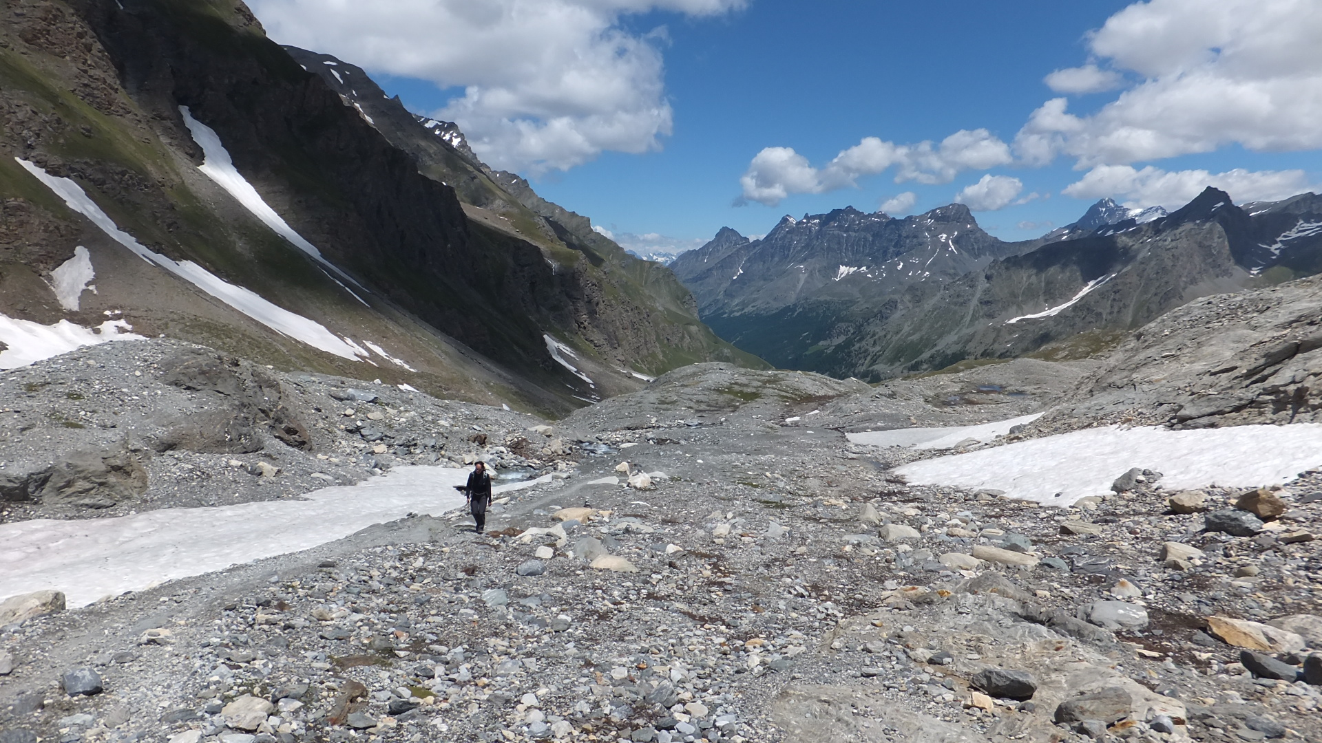
Sabine van der Veer
Professor in Health Informatics
Co-investigator Health Research from Home
Loves a mountainous hike
Enjoys bird watching and brutalist architecture

Slide 41
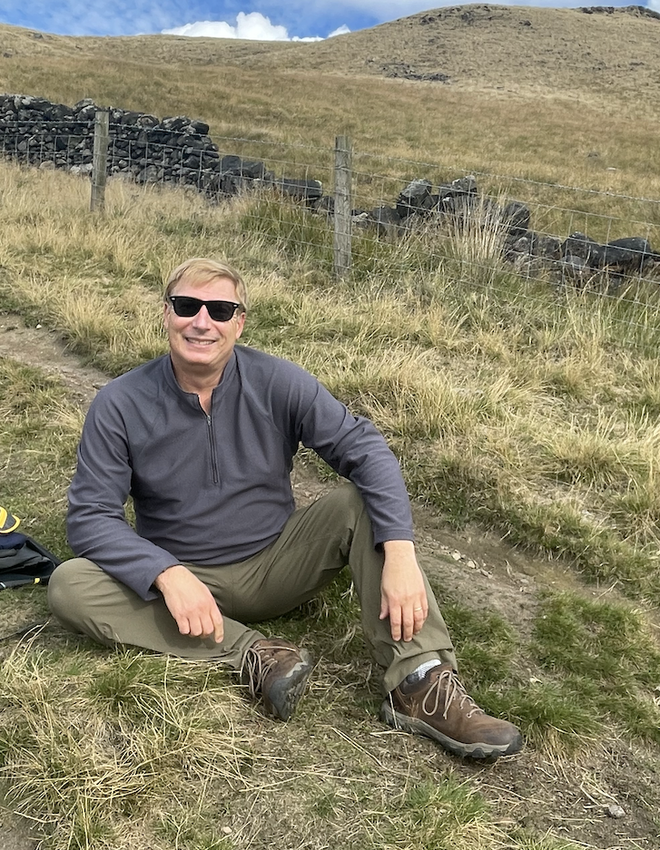
David Schultz
Add picture outside of work
Prof of Synoptic Meteorology
Author of Eloquent Science: A Practical Guide to Becoming a Better Writer, Speaker, and (Atmospheric) Scientist
Will’s hired help
Looking cool while hiking
Finding the best Effin’ Birds cartoon for any given situation

Slide 42
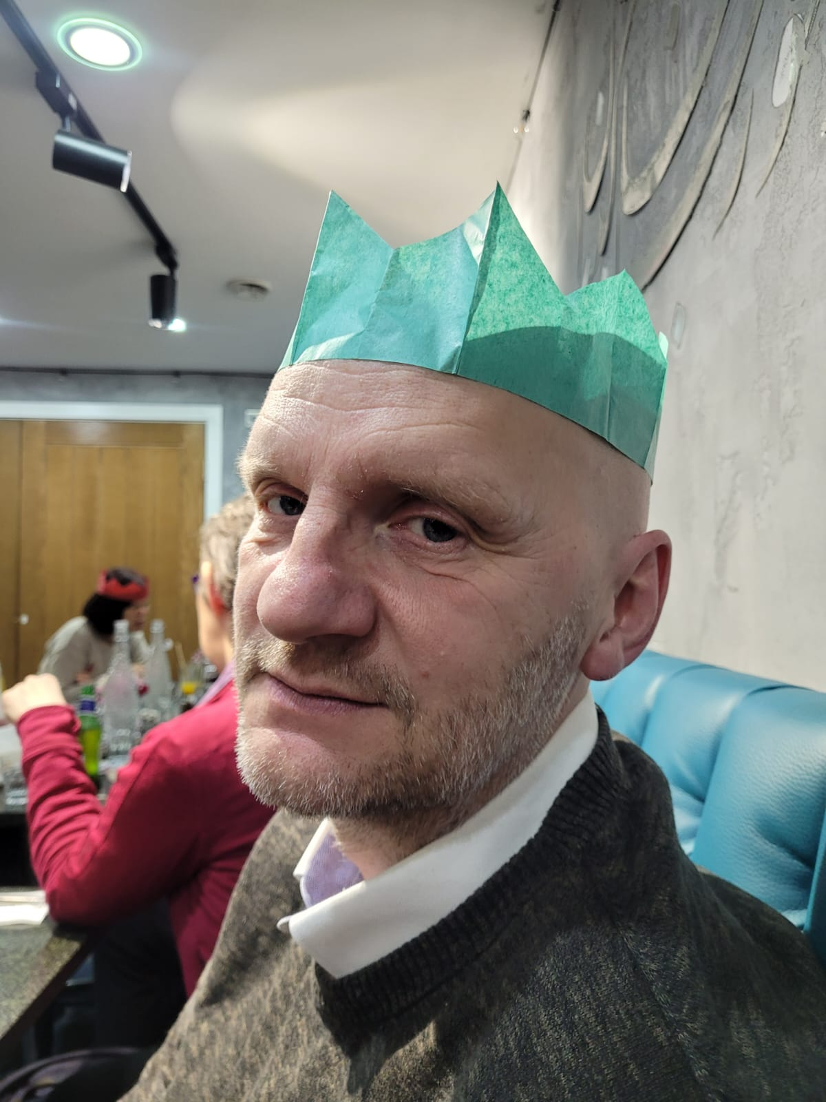
Peter Bower
Ad picture outside of work
Health services researcher
Occasional ‘reviewer 2’
Party lover

Slide 44
Pitches v2
Judging criteria
• Background and clarity of unmet need
• Clear research Q, with appropriately matched methods
• Well designed PPI plans
• Well articulated need for smartphones & wearables, with feasible plans for technology delivery
• Response to panel’s questions
Prepare an oral presentation of no more than eight minutes
  Present as an individual or team
  Must include
    Background
    Aims and objectives
    Methods
    PPIE/ technology/ IG (the advice clinics)
    Anything else you think important
Two minutes Q&A
Prizes

Slide 46
Opening session
Introduction to Health Research from Home
Purpose of the grant writing retreat
Agenda for the event
  And introduction to the faculty
Getting to know you

Slide 47

Getting to know you
You have 15 mins to talk to as many people as possible and find a person for each box
Can only use each person once
Can talk to facilitators as well as delegates
Shout out ‘‘Bingo!’’ if you complete one row/column.
After 15 minutes:
Introduce yourself and share which blue highlighted bingo square best describes you.
Form three groups of 6-7 people with a mix of the blue highlighted characteristics

Slide 48
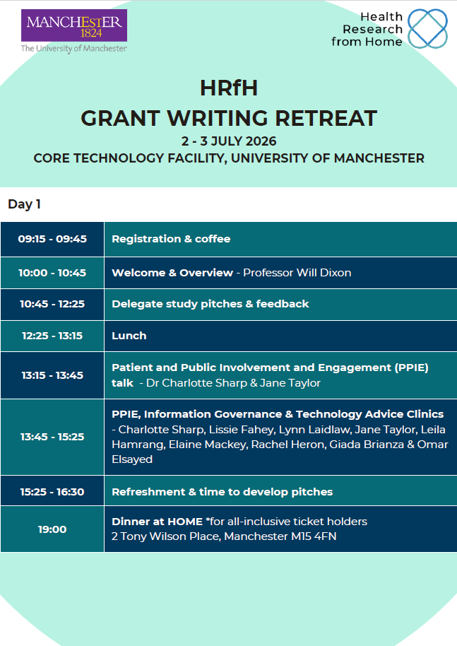
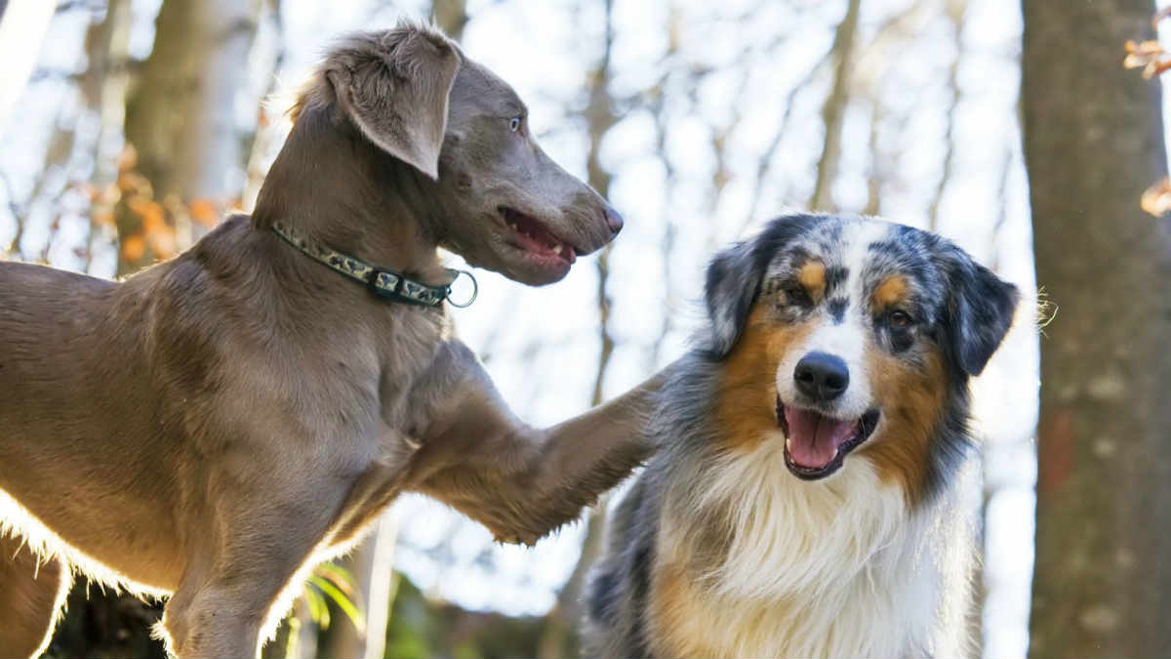
Group 1: Innovation (Will, Leila, Lissie, Giada)
Group 2: Boardroom (Charlotte, Jane, Omar)
Group 3: Rutherford (Sabine, Charlie, Lynn)

Slide 49

The pitch
Importance of area
Clarity of purpose
Design delivers your aims
Feasible

Slide 50
Group 1
1345-1435 PPIE (Innovation)
1435-1525 Information Governance (Boardroom)
Day 2 Technology (Rutherford)
Group 2
1345-1435 Technology (Rutherford)
1435-1525 PPIE (Innovation)
Day 2 Information Governance (Boardroom)
Group 3
- 1345-1435 Information Governance (Boardroom)
1435-1525 Technology (Rutherford)
Day 2 PPIE (Innovation)

Slide 51
Group 1: Will, Leila, Lissie, Giada (Innovation)
Laura Kinsey Omar Elnaggar
Alex Kenny Laura Ormesher
Adriana Wilde
Abdulaziz Alrubayyi
Group 2: Charlotte, Jane, Omar (Boardroom)
Marie-Louise Zeissler Fanqi Zeng
Viveka Biswas Charles Gyasi
Mouna Rafizadeh
Group 3: Sabine, Charlie, Lynn (Rutherford)
Sophie-Christin Ernst Precious Onyeachu
Nikita Nalawade Ed Sadula
Ji-Jian Chin

